Slide 1
Staying Healthy Assessment Training (SHA) Provider Relations June 2016
Guidelines for non-clinical staff and providers on how to complete the Staying Healthy Assessment

Slide 3
Staying Healthy Assessment (SHA)
The Staying Health Assessment (SHA) is an (IHEBA) approved by the Department of Health Care Services (DHCS).
It is designed to help determine and meet any specific behavioral health education needs that patients might require.
It consists of seven age-specific pediatric questionnaires and two adult questionnaires. Our threshold language English, Spanish, and Russian are available on PHC website. Information on other languages are available.
Partnership Health Plan of California (PHC) wants our providers to meet state regulations to ensure Medi-Cal members’ healthcare needs are met.
The SHA through a set of questionnaires can help providers identify high-risk behavior, set priorities for behavior change, and refer patients for appropriate services.
The State may audit your office to ensure the SHA is being used.

Slide 4
Front and Back Office Staff

Slide 5
Goals for Front and Back Office Staff
Identifying and tracking high-risk behaviors of insured members.
Prioritizing each member’s need for health education to lifestyle, behavior, environment, and cultural and linguistic needs.
Providing tailored health education, intervention options, referral and follow-up.

Slide 6
SHA Completion By Member
Explain the purpose and how the SHA will be used by primary care providers (PCP).
SHA forms are available in multiple languages.
Interpretation services if needed.
Assure confidentiality of SHA responses, and that the patient has the right to skip any question.
Parent or caregiver must complete the form for children under 12 years.
Self completion preferred method for accurate response to sensitive questions.
If a member refuses to complete the SHA, it must be documented on an age-appropriate SHA questionnaire.
PCP or other clinic staff may ask questions and record responses.

Slide 7
Patient Initial Visit
Front office staff includes the SHA as part of the initial packet prior to a visit with clinical practitioner.
Length of scheduled appointment to initiate the SHA may be case specific. Appointment schedule arranged in accordance with appointment time.

Slide 8
IHA Visit & SHA Age Groups
The IHA visit is required within120 days of enrollment. The SHA assessment is completed during member’s initial encounter. Starting at age 3 years, review every 12 months. Highly recommend for seniors due to risk factors.
0-17 Years - Within 120 days of enrollment
7-12 Years - 1st Scheduled Exam (after entering new age group)
Adults and Seniors - Administer every 3 to 5 years. PCP reviewed, and initialed.

Slide 9
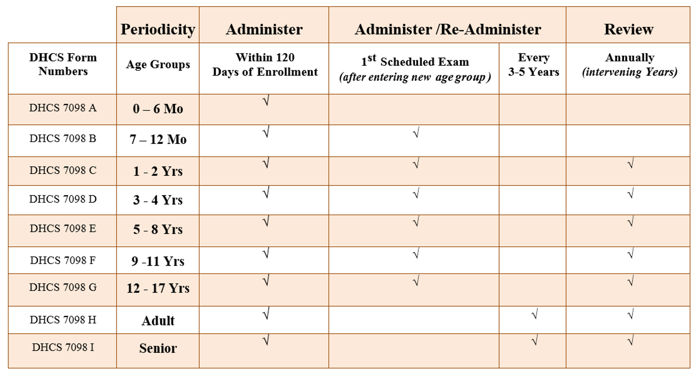
SHA Periodicity
Notes:
The presenter will explain what the periodicity grid is.

Slide 10
SHA Questionnaire Adult
Notes:
The presenter will explain the SHA questionnaire.

Slide 11
SHA Questionnaire Child
Notes:
The presenter will explain adult questionnaire.

Slide 12
SHA Questionnaire Adult
Notes:
The presenter will explain the child questionnaire.

Slide 13
SHA Questionnaire
Notes:
The section is completed by clinical practitioner.

Slide 15
Clinical Providers (MD, PA, FMNP, DO)

Slide 16
Primary Care Providers (PCP)
The PCP are responsible for reviewing each member’s SHA in combination with the following relevant information:
Medical history, conditions, problems, medical/testing results, and member concerns.
Social history, including member’s demographic data, personal circumstances, family composition, and social support.

Slide 17
Physician’s Role
Review the completed SHA with the member and start a discussion with the member regarding behavioral risks the member identified in the assessment.
Prioritize each member’s health education needs and start discussion and counseling regarding high-risk behaviors.
Based on the member’s behavioral risks and willingness to make lifestyle changes, the PCP should:
Provide tailored health education counseling, intervention, referral, and follow-up.
Review the SHA with the member during the years between re-administration of a new SHA assessment.
Sign the SHA Annual Review section of the questionnaire to document an annual review was completed and discussed with the member.
Providers can use an alternative IHEBA with prior approval of the Medi-Cal Managed Care Division (MMCD).

Slide 18
Provider Training
PHC must provide resources and training to providers and subcontractors to ensure delivery of culturally appropriate patient health education services.
SHA Requirements
Instructions on how to use the SHA or DHCS approved alternative assessment
Documentation requirements
Timelines for administration, review, and re-administration
Specific information and resources for providing culturally and linguistically appropriate patient health education services/interventions

Slide 19
SHA Attestation
Notes:
Please note the attestation of staff training is an example form.

Slide 20
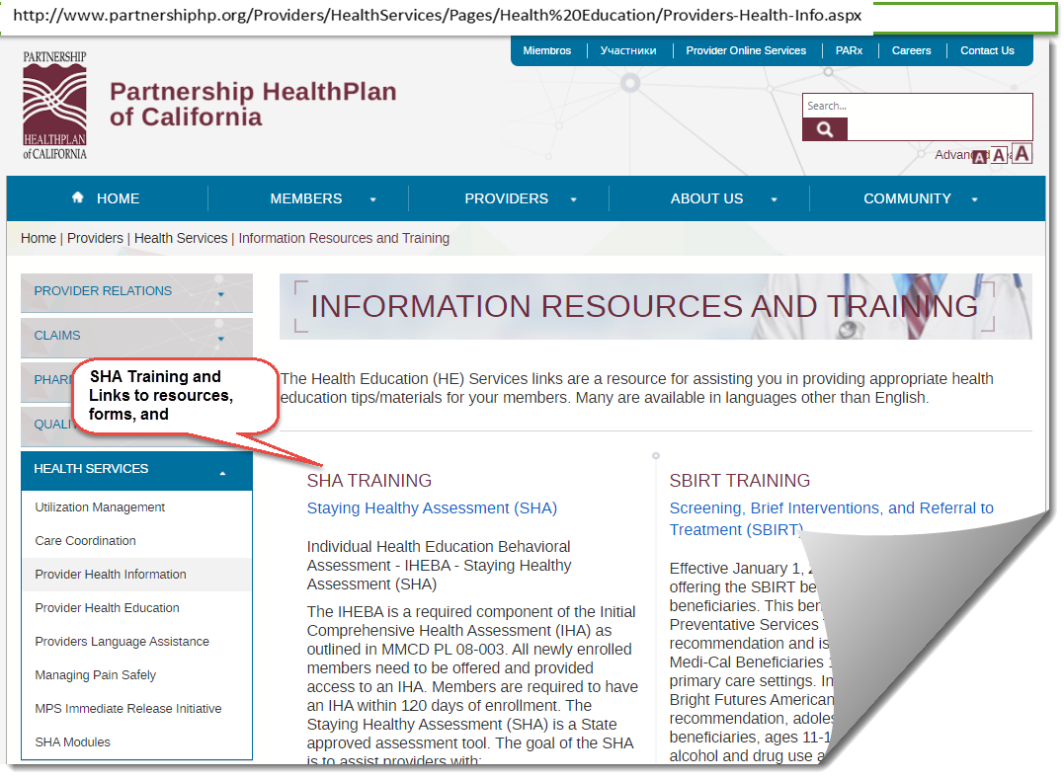
SHA Resources on the PHC Website
SHA questionnaires and resources are available on the PHC website at:
http://www.partnershiphp.org/Providers/HealthServices/Pages/Health%20Education/Providers-Health-Info.aspx

